Slide 1
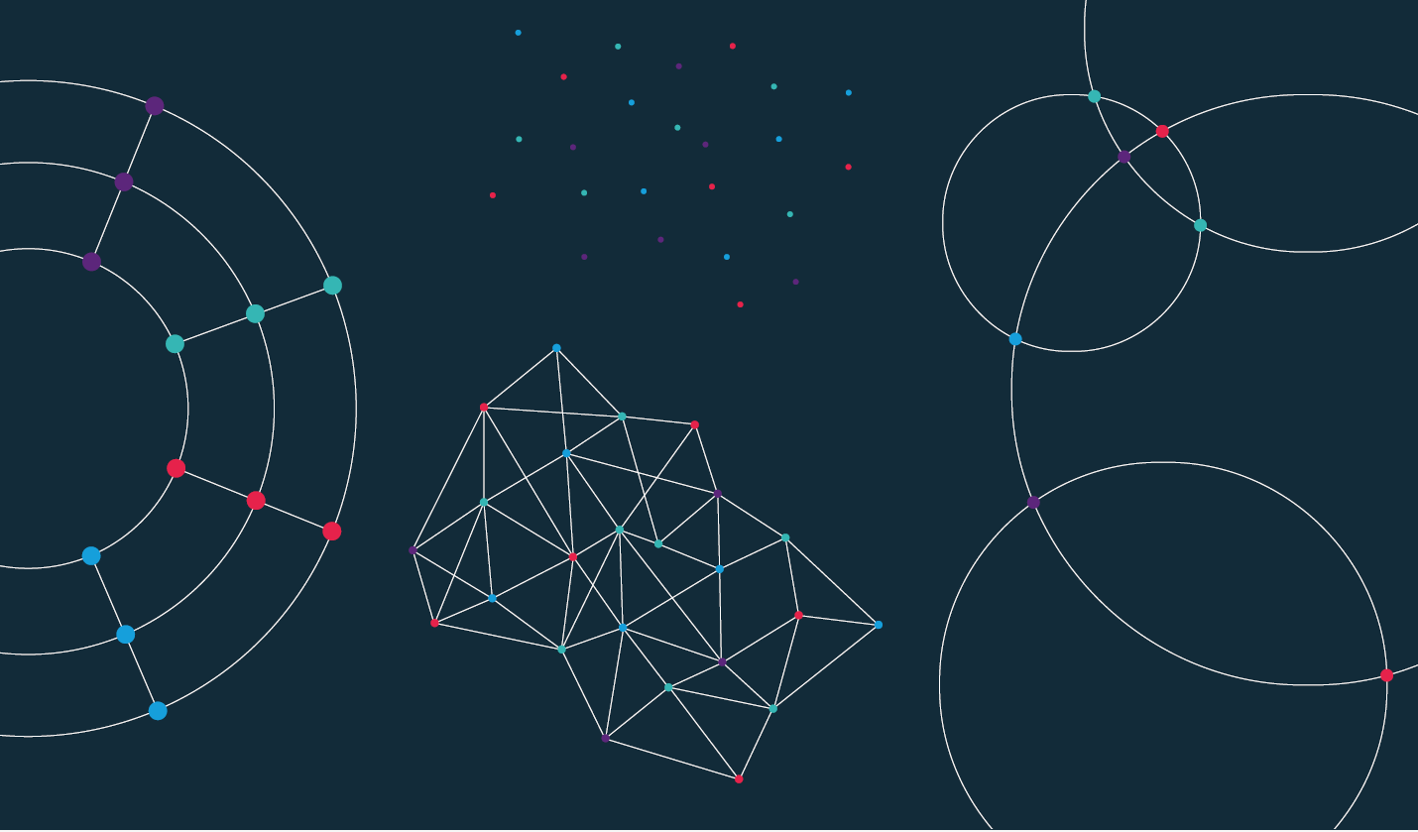

Slide 2
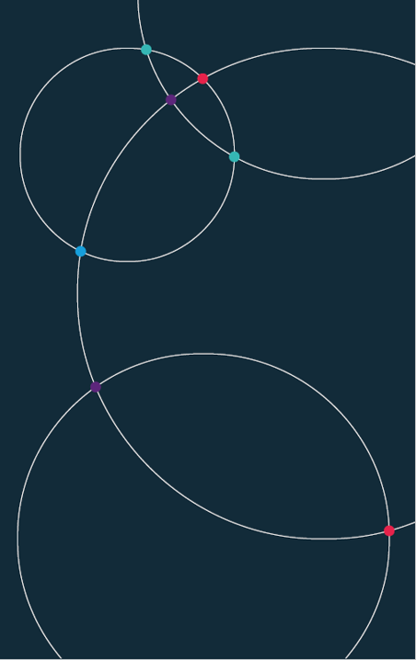
Data Science. Week 1. Seminar

Slide 3
Week 1. Reminders
Reminder: Office hours.
RD: Tues, 14:00-15:00 (TBC)
DC: Thu, TBC (online)
FM: Wed, 14:30-15:30 (TBC)
JH: Thu, 10:00-11:00 (online)
Reminder: Portfolio tasks
These are set each week and make up 20% of your grade. They can be found in the course DropBox. The file is here

Slide 4
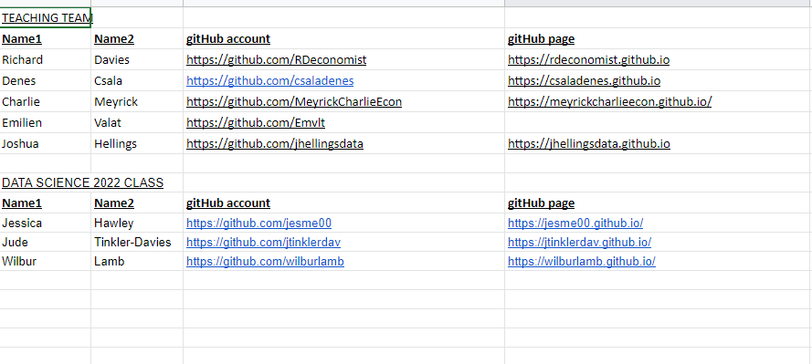
Week 1. Reminders
Reminder: Class Google Sheet
Please add your name, student ID, GitHub account details to the class spreadsheet. This is here

Slide 5
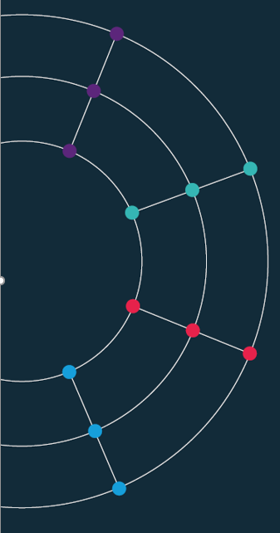
DS Skills. Some CSS basics

Slide 6
Data Science projects.

Slide 7
Assessment. {Deadline: 6th Dec 11am}
Coursework. The coursework consists of two parts.
DS Portfolio (20%). In each of the first 10 weeks you learn the steps to produce charts, tables or visualisations. These are worth 20% of your grade. Each week is graded equally, i.e. 2%. These should be completed during the week. Note that the portfolio is NOT the same as for 2022.
DS Project (80%).
Between 3 and 8 charts. Embedded in your site, hosted by GitHub pages.
An accompanying write-up (also embedded on your page) discussing:
the aims of your project;
the data you used, how you accessed it, including notes on automation/replication;
challenges in data cleaning and/or analysis, and the tools you used to overcome them;
your conclusions.
Each section must not exceed 200 words.

Slide 8
From the archive. Some of the best projects from previous cohorts
Projects from last year can be found here: https://rapidcharts.io/datascience2022
Lets discuss them….

Slide 9
Marking criteria.
Accessibility.
Hosted on a GitHub page – open data approach
Clear link to data and notes in code
Mobile first: site should be clear on a smartphone screen
Design.
Clarity of question
Choice of data sets
Empirical approach
Automation.
Use of APIs
Replicability of project
Impact.
Key takeaways from the project
Interactivity of the data
Description.
Clarity of write up
Logical steps from data to conclusions
Does the project stimulate further work?

Slide 10
DS projects. Some more ideas.
Set out a question you are interested in and answer it using data.
Some ideas:
Is Bitcoin really digital gold?
How does the return, volatility of BTC compare to precious metals?
Does GDP lead to gold medals?
GDP per capita and Olympic success, over time.
Is inflation miss-measured?
Comparing official price data with reports from scrapers
Covid and the housing market.
Which areas saw the biggest changes in prices?
5. Wages and productivity – a local approach.
Does local productivity drive changes in wages?

Slide 11
DS projects. Some more ideas.
More ideas:
6. Gun control and education outcomes
Is there a relationship between gun control legislation and school outcomes in the US?
7. Gambling and the economy
Do people gamble more during a recession?
8. Female literacy rates in emerging markets over time
How have female literacy rates in emerging markets evolved over time, under different political regimes?
9. Pollution and mental health
Does living in a polluted area have a causal impact on people’s mental wellbeing?
The rise of far-right populism
Comparing labour market trends with vote share/support for far-right political parties

Slide 12
DS projects. Some more ideas.
Even more ideas:
11. Sustainable energy transition
Which countries are leading the transition to renewables?
12. Climate change and natural disasters
Have natural disasters become more frequent across the globe in the past two centuries?
13. Electric vehicle adoption
Where and which are the most popular electric vehicles?
14. Jevon’s Paradox in transportation
Do people drive more as their cars get more efficient? How about when they go electric?
15. Gaming live-streamers and company sponsorship
Who are the most popular live streamers? Does this translate to more income to the game companies?
16. Crypto economy
Altcoins: do listings on an exchange, ICOs/IEOs work? What is the effect on the token price?

Slide 13
Project scoping. Questions to ask before you decide on your project.
Today: Scoping out projects
Questions to answer:
What is the question I want to answer? (Think of two or three)
Does data exist? (Can you find an API, or a website displaying the information you can scrape?)
What would my data plan be? (How often would you access the data? A set number of times? Every day?)
What analysis will I use? (Are you looking for correlations? Causation? How things change over time?)
Is my project:
Interesting?
Novel?
Challenging?
Realistic?

